Slide 1
Project: Dogs, Fried Chicken or Blueberry Muffins?
Group#1 Members:
Christina Huang
Henrique Saboya
Yi Zhang
Joaquim Lyrio
Jing Zhao

Slide 2
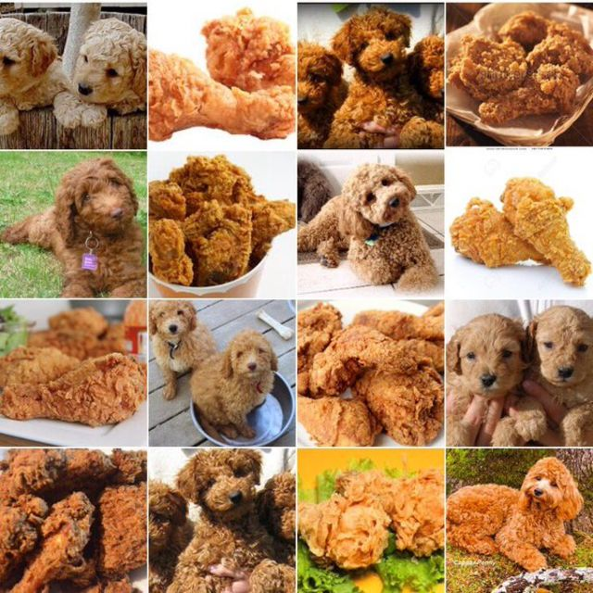
Introduction
In this project, our goal is to classify whether an image is dog, fried chicken or blueberry muffin. We have been given 3,000 images to train our baseline and proposed models, and will run the test on the other 3,000 images.

Slide 3
Project PIPELINE
Step1
Step2
Step3
Feature Extraction
Model Training
Model Selection
Results
Step4

Slide 4
Feature Extraction
SIFT—Scale invariant feature transform
a classical approach, local descriptor
rotation and scale invariant
HOG—Histogram of oriented gradients
global descriptor
PCA—Principal Component Analysis
Create PCA components in HOG features
CNN—Convolutional Neural Network
2 convolutional layers+ normal layers

Slide 5
Our MODELs
Baseline Model
Gradient Boosting Model with SIFT features
Advanced Models
SVM – Support Vector Machine
RF—Random Forest
LDA—Linear Discriminant Analysis
CNN—Convolutional Neural Network

Slide 6
Model selection
--Using SIFT Features
 |  | SIFT
 |  | CV Lowest error Rate | Training Time (seconds) | Best Parameters
GBM |  | 20.67% | 181.489 | Shrinkage = 0.06
Baseline Model

Slide 7
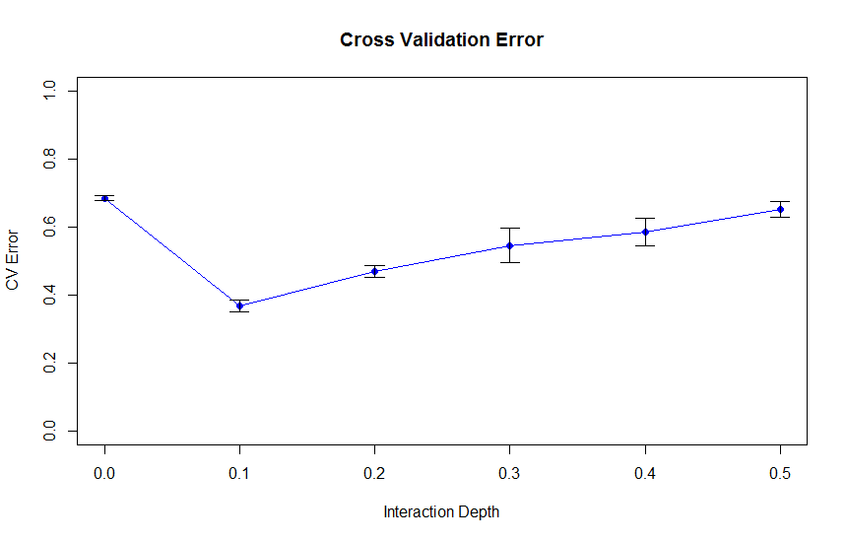
Model Selection
--Using Hogs Features
Baseline Model
SVM Model
Notes:
--HOGs features
--Visulize Cross-Validation Results for GBM and SVM

Slide 8
Results
 | HOGs
 | CV Lowest error Rate | Training Time(seconds) | Best Parameters
GBM | 40.83% | 4.04 | Shrinkage = 0.06
LDA | 36.93% | 0.05 | NA
SVM | 36.83% | 4.25 | Gamma = 0.1
RF | 35.60% | 66.72 | mtry= 20, trees = 2000
Notes:
Train the model with all training data using best params

Slide 9
Model Selection
--Using CNN features
Baseline Model
Random Forest

Slide 10
Results
 | CNN
 | CV Lowest error | Training Time (seconds) | Best Parameters
GBM | 9.60% | 0.745 | shrinkage=0.01
LDA | 9.50% | 0.004 | NA
SVM | 9.60% | 0.162 | Gamma=0.5
RF | 11.07% | 6.865 | mtry=21, ntrees=2000
CNN | 6.20% | Approx 2h | Learning Rate=0.01, Batch size=64, Validation Size=0.2

Slide 11
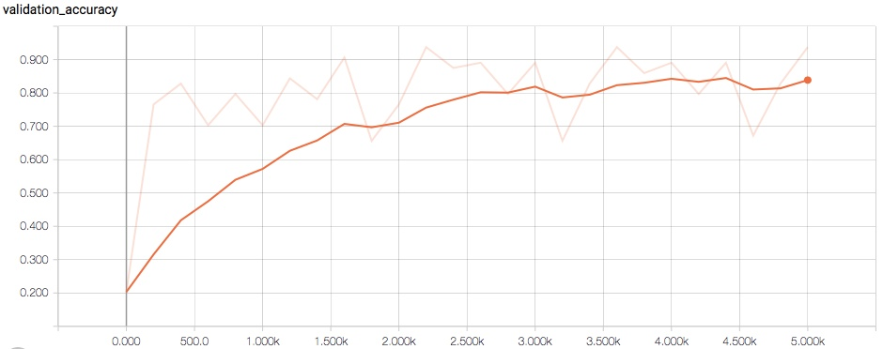
Best Model--CNN

Slide 12
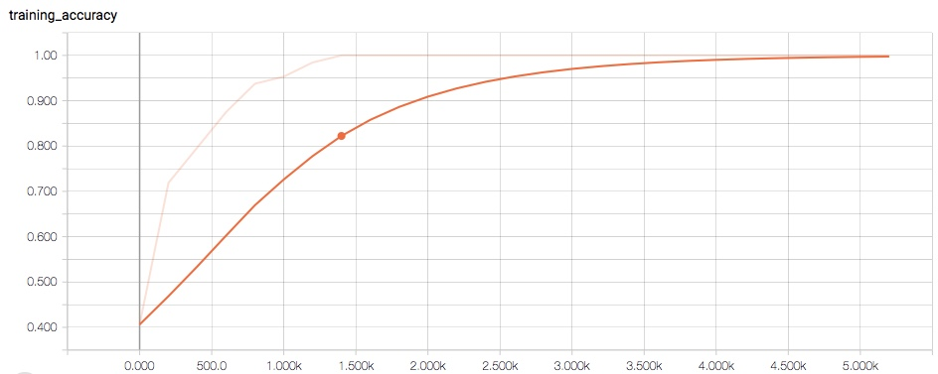
Best Model--cnn

Slide 13
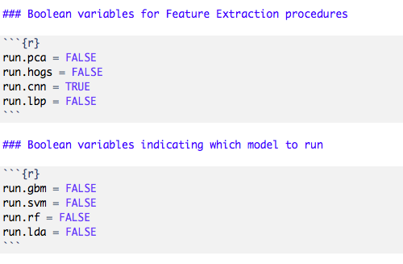
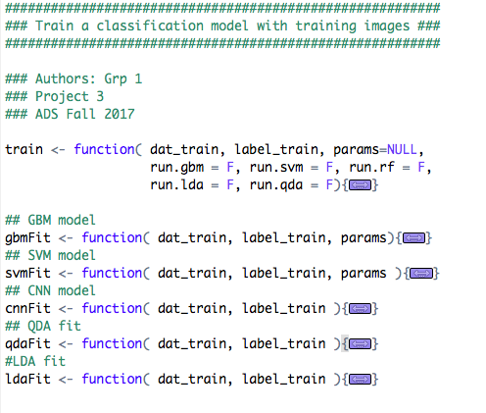
Codes

